Slide 1

HIQuad X Technical Product Presentation
Sebastian Dänner Product Manager HIQuad X

Slide 2
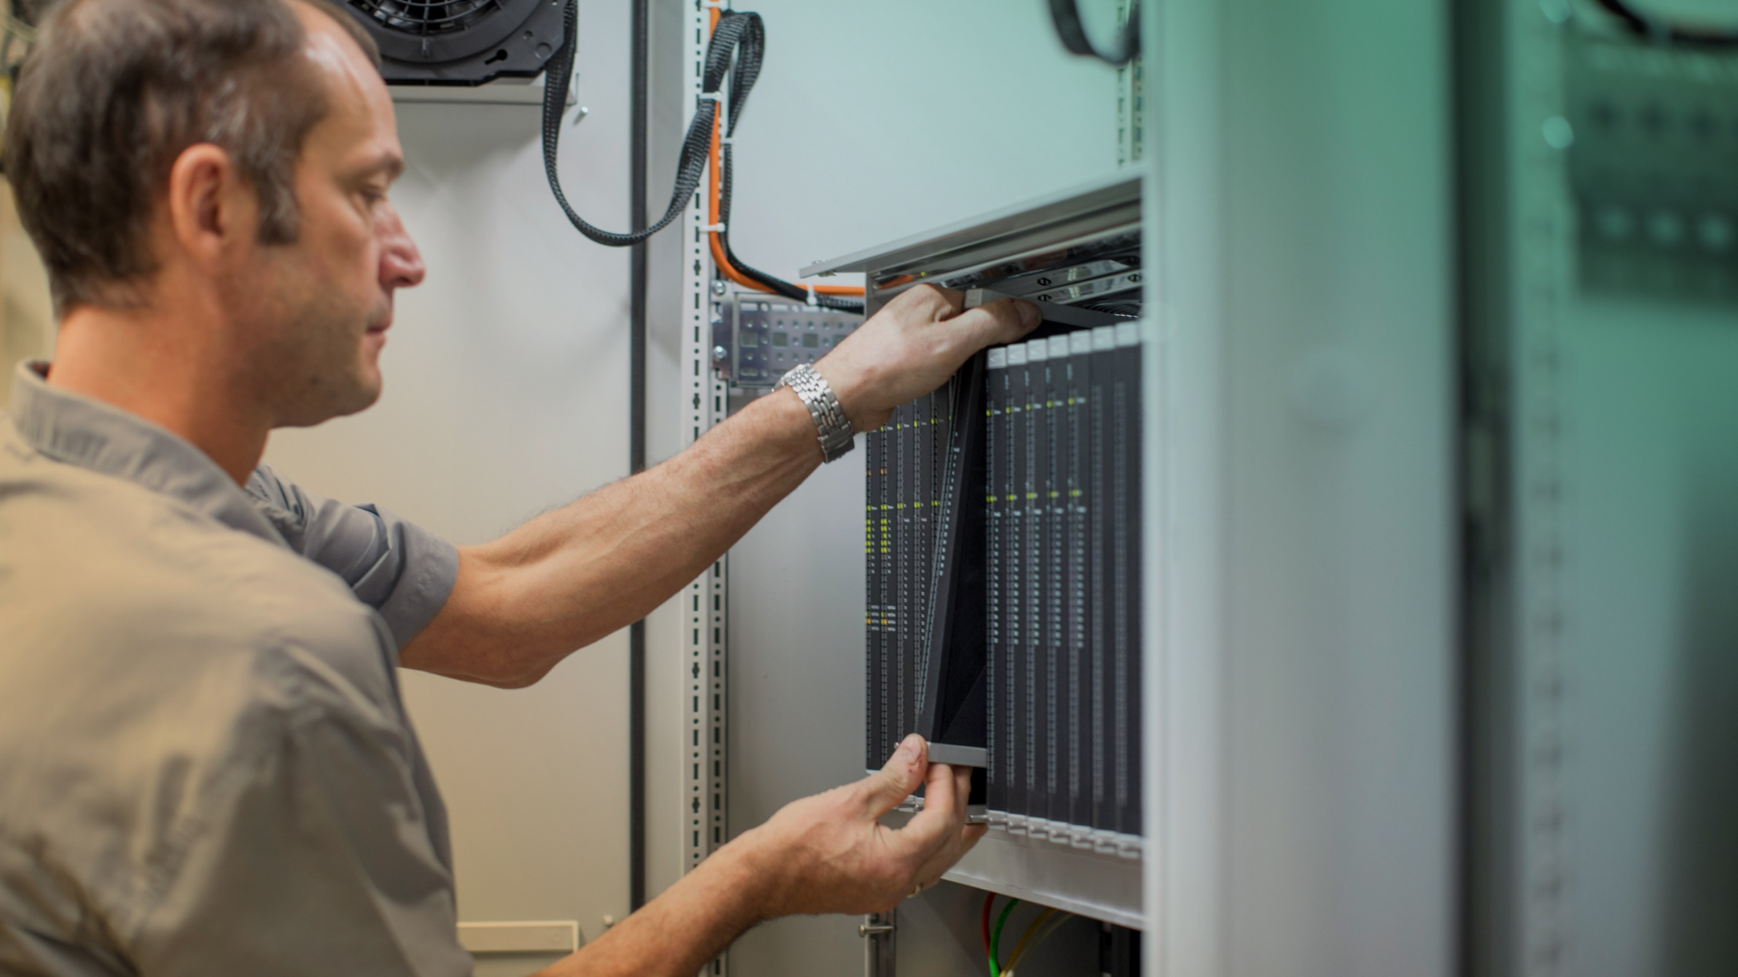
HIMA Smart Safety Platform
Notes:
Moving on to our products.
As you are about to see, no matter what the requirements a safety system has, we create the perfect solution.
What’s more, our systems are always reliable, cost effective, and smart.
All our systems are based on open communication protocols, making them easy to integrate with any control system or automation environment.

Slide 3
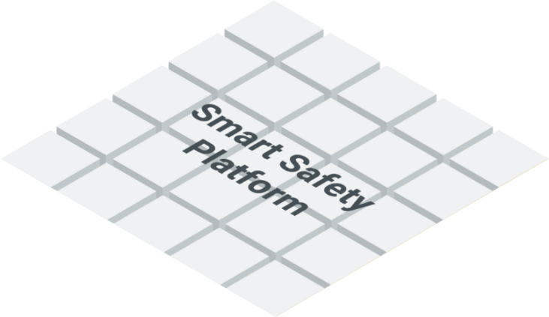
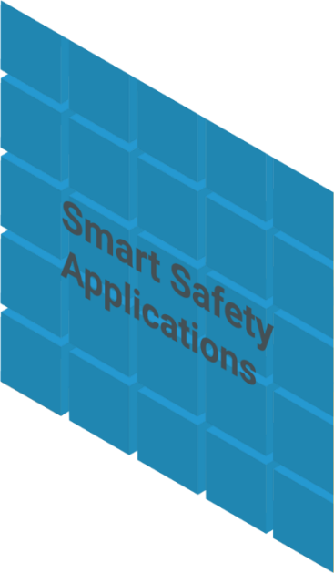

The Four Customer Perspectives
Reliability
Safety
Rely on decades of safety experience, proven technologies, and expert services.
Always comply with safety standards.
Profitability
Security
Run your plant safely, but efficiently and profitably at the same time.
Your safety automation and critical assets are always protected.
Notes:
The four key outcomes of the Smart Safety concept are safety, security, reliability, and profitability.
Safety: Fulfill the requirements of safety standards and regulations, and reduce risks.
Security: Protect your automation systems and critical assets from cyberattacks and other cyber risks.
Reliability: Expert services and proven technologies keep your plants and machinery up and running.
Profitability: Increase the efficiency and yield of your plant, while keeping it safe at the same time.

Slide 4
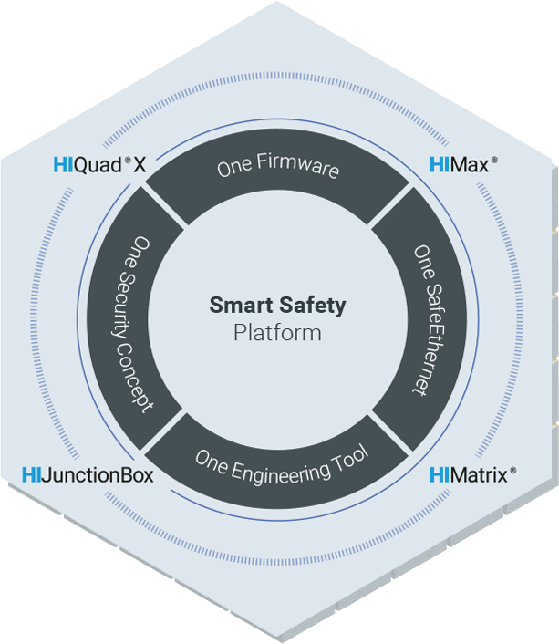
Smart Safety Platform
Your benefit: Reduce the complexity of your safety systems and stay protected against ever-increasing risks.
The world’s first scalable safety platform with built-in cybersecurity.
Notes:
First of all, allow me to explain our brand-new Smart Safety Platform. It is the world‘s first complete, cybersecure safety platform. It comprises 4 HIMA products (HIMax, HIMatrix, HIQuad X, and HIJunctionBox). These share the same engineering tool, the same security concept, the same firmware, and the same communication protocol.

Slide 5
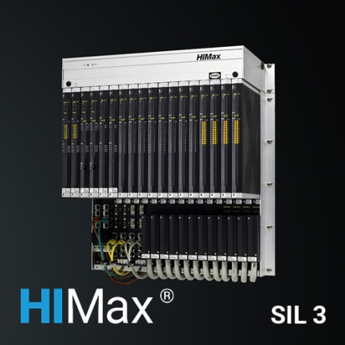
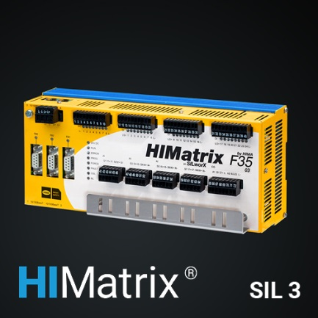
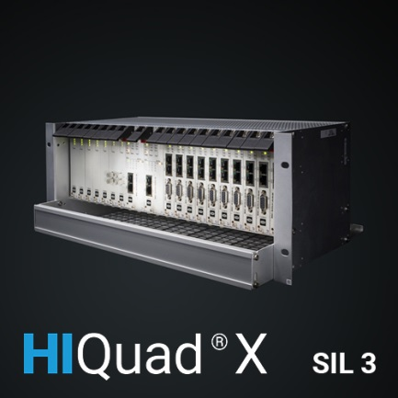
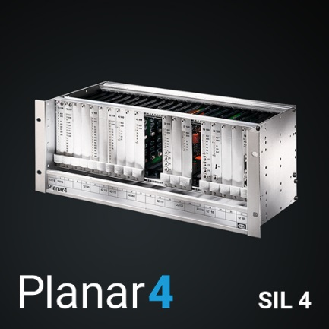
HIMA Product Portfolio – The Mission
Support existing installations with a long term strategy for investment protection.
Smart Safety Platform including HIQuad X.
Continuous developments strengthens our Smart Safety Platform.
Safe interoperability of HIMA Systems including HIQuad and optimization of their integration.
Comprehensive modernization services for Legacy Systems.
Future aim: Expanding our HIMA safety product portfolio.
Notes:
Here you can see all of our safety control systems.
They can be used up to SIL 3 and, in the rail industry, up to SIL 4 according to CENELEC standards. Our hardwired safety controller Planar4 is even approved for use up to SIL 4, the highest safety level there is.

Slide 6
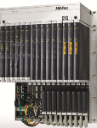

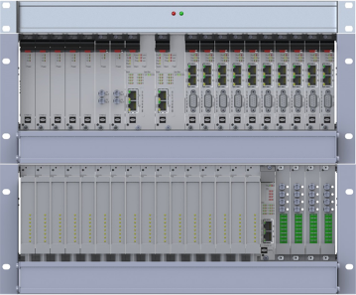
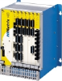
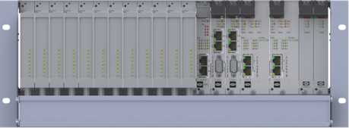
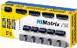
Product Portfolio HIMA safety PLCs – 2020
I/O Points
2000
1000
500
200
100
Performance

Slide 7
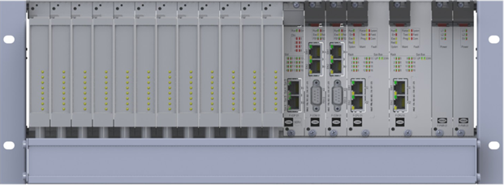
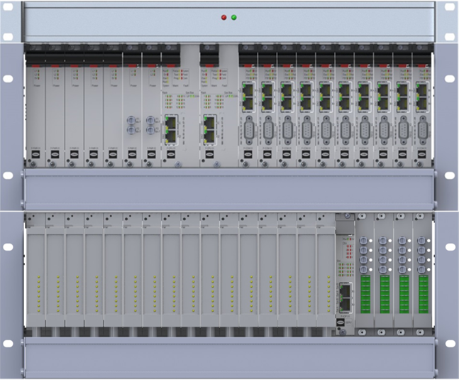
Product Launch HIQuad X
The flexible, scalable safety control system for a wide range of applications.
Notes:
HIQuad systems are highly reliable and can be configured flexibly. They are designed for small and midsized applications in the process industry.
They protect both central and distributed applications with maximum fault tolerance.
They are so flexible that they even allow you to make program changes during operation.
Since launch, HIQuad has become the benchmark for reliable and cost-effective safety solutions in the process industry.

Slide 8
Why are we developing HIQuad X?
Why the name HIQuad X?
HIQuad stands for reliability - 1,000 times proven.
The capital letter X – for SILworX programming.
We want…
to fulfil our long term lifecycle commitments.
to protect our installed base of more than 10.000 HIQuad systems.
to be a trustful partner for safety technology.
We offer our customers …
an attractive way into the SILworX world.
to keep the majority of his investments.
to continue his proven in use safety technology and to improve it selectively.
Notes:
Warum kam es zu dem Name HIQuad X?
HIQuad ist DAS Basis Sicherheitssystem der HIMA. In vielen Ländern (China, Malaysia, aber auch in Europa) repräsentiert HIQuad und Ihre Eigenschaften die HIMA. Sie ist prägend und hat einen ausgesprochen angesehenen Name. Er steht für Zuverlässigkeit. HIQuad ist eine Marke mit einem Wert. Diesen Wert wollen wir erhalten und in die Zukunft überführen.
Das X steht für die etablierte HIMA Plattform, die wir mit SILworX bedienen. Seit HIMax ist das X mit der Performance unserer Sicherheitssteuerungen gleichzusetzen. Es ziert jedes HIMax Modul. Auch die Verfügbarkeit wird seit HIMax mit X-MR Architektur auf ein neues Level gehoben.
X bedeutet:
Verfügbarkeit
Nonstop Operation
Flexibilität
State of the art Safety & Security
Die HIQuad mit dem Mehr an Emotionen des X auszustatten, war seit Beginn der Idee das Ziel.

Slide 9
Product Positioning within HIMA Product-Portfolio
HIQuad X consisting of H51X/H41X is going to be the future Basic-Safety System
Applicable for up to SIL 3
With standard and high availability and integrated intrinsically safety modules HIQuad X (H51X/H41X) will be the future of HIQuad (H41q/H51q).
HIQuad X (H41X) is going to serve small systems with affordable costs.

Slide 10
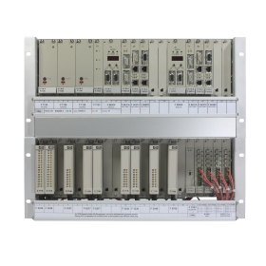
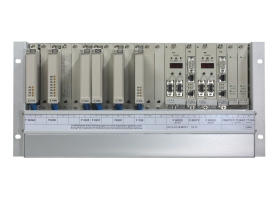
What are the benefits of HIQuad X?
New installations and modernization of existing systems:
Up to date security concept
One engineering platform
Increased performance
Enhanced reload functionalities
Comprehensive communication options
Safe communication among HIMA systems
Modernization of existing HIQuad systems:
No change of HIQuad I/O including field wiring
Shorter plant shutdown times for upgrades
Less effort upgrades compared to new installations
H51X
H41X
New
New

Slide 11
HIQuad X – System Features
The flexible, scalable safety control system for a wide range of applications.
Notes:
HIQuad systems are highly reliable and can be configured flexibly. They are designed for small and midsized applications in the process industry.
They protect both central and distributed applications with maximum fault tolerance.
They are so flexible that they even allow you to make program changes during operation.
Since launch, HIQuad has become the benchmark for reliable and cost-effective safety solutions in the process industry.

Slide 12
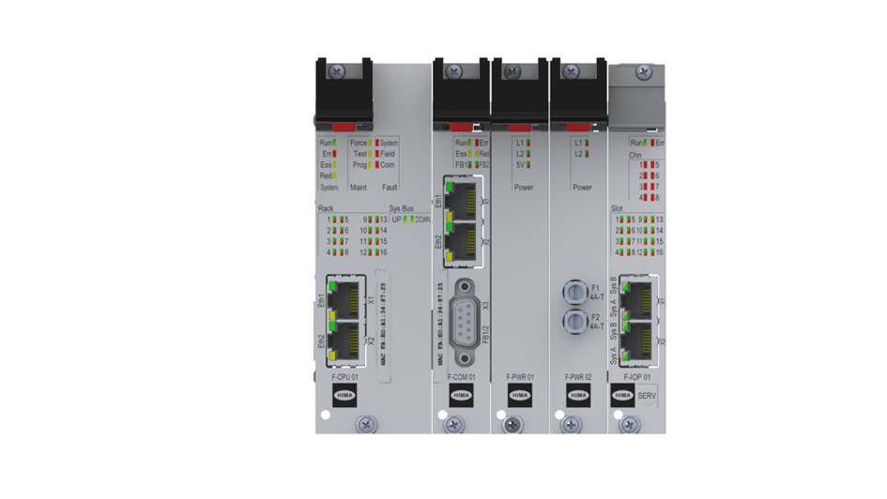
Design of new modules
Design:
Modernized Design
Local diagnosis concept improved
Improved haptics
F-CPU 01: Processor module H51X, H41X (2 x RJ-45, SIL 3)
F-COM 01: Communication module for Ethernet, Profibus DP and serial communication(2 x RJ-45, 1x 9-pole D-Sub (2x RS 485)
F-IOP 01: I/O processing module (SIL 3) with redundant system bus
F-PWR 01: Power supply module 24 VDC / 5 VDC, 50 W, H41X, H51X
F-PWR 02: Watchdog supply module for extension rack, H51X

Slide 13
HIQuad X – New performance dimension
Higher performance through
Better REAL calculation possibilities
Lower system cycle times and reaction times
E.g. 200 I/O points at 50 ms cycle time possible
New application opportunities
Formerly separated HIQuad systems can be combined – Multitasking helps for separation needs
Allows optimization of application program, which improves
Better understanding of application
Shorter maintenance time through faster failure tracking
Higher safety awareness through clearer structure
A target cycle time can be used for HIQuad X in SILworX
e.g. to emulate a similar behaviour of the former HIQuad system

Slide 14
HIQuad X – flexible system architecture
Input
In
In
Redundancy options at every point
CPU modules
I/O modules
I/O Racks
COM modules
Cross connection increases system availability
Every I/O module is connected to every CPU
CPU modules share the results among each other
Power Supply
CPU
CPU
Power Supply
Out
Out
No degradation of safety and
availability
Output
SIL3
& maximum available

Slide 15
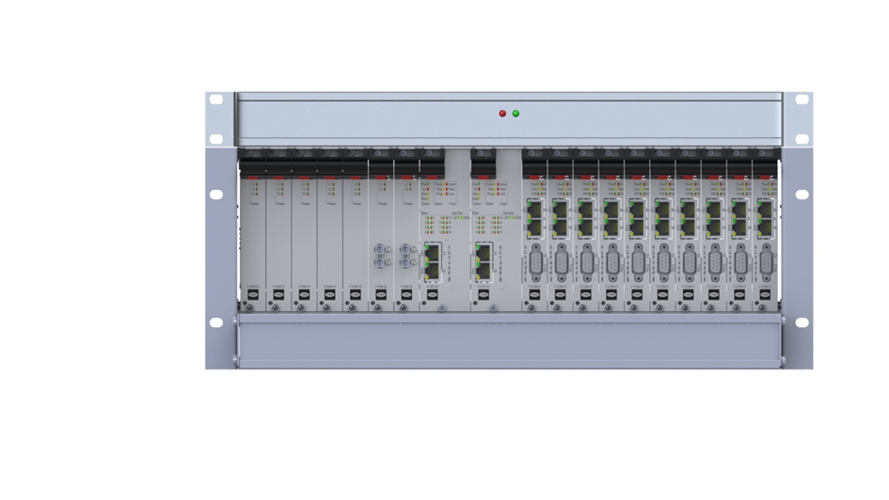
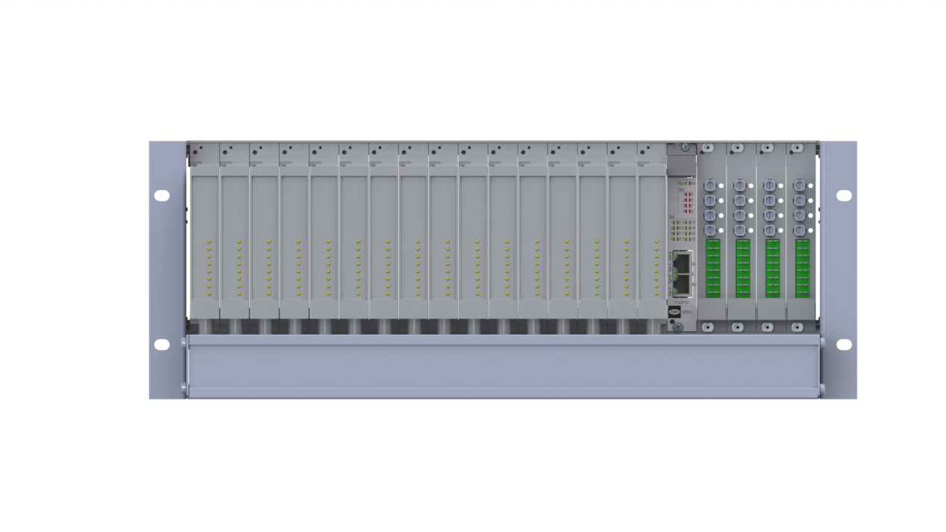
HIQuad X – Availability
New: Ethernet based system bus communication between Basic Rack and I/O Extension Racks
Fault tolerant bus concept with two F-CPU 01
Increased system bus fault tolerance on H51X
Physical separation with Ethernet infrastructure between F-CPU 01 and F-IOP 01
Higher system robustness through usage of Ethernet system bus (no cross talking over the lines)
F-IOP 01 provides freedom of interference from I/O to F-CPU 01
Reload technology of Smart Safety Platform
Reload with one F-CPU 01
Add, change, delete
Application
Hardware
communication

Slide 16
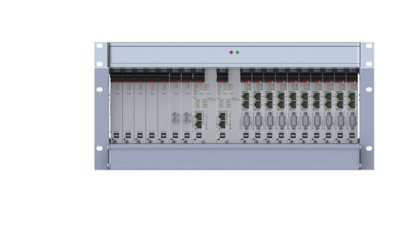



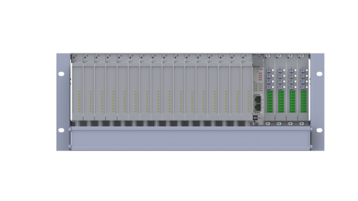
HIQuad X – How a Reload works
DOWNLOAD means to change the application the PES needs to be STOPPED
AP 1
AP 1
AP 2
AP 2
RELOAD means the change of the application program is done ONLINE
AP 1
AP 2
AP 1
AP 2
t

Slide 17
RELOAD: Online Changes & Modifications
Operation of application in A
Reload of changed application in B
Memory B
Verification of changes
Memory A

Slide 18
RELOAD: Online Changes & Modifications
Operation of Application in A
Operation of application in A
Reload of changed application in B
Memory B
Verification of changes
Memory B
Memory B
Switch over to B in the next cycle
Memory A
Memory A
Memory A
Operation of application in B

Slide 19
HIQuad X – Engineering
One common engineering Tool SILworX
Less space compared to former HIQuad architectures
Flexible I/O configuration
Wiring effort reduced – higher degree of integration
New backplane of F-BASE RACK 01 & 02 reduces susceptibility (less wiring and open contacts)
M 4410: Cover plate for the rear side of the F-BASE RACKs (to protect open contacts)
Accelerated Start-Up through enhanced diagnosis
Basic Rack only 4 units high
Later: New fan with vacuum evacuation F-FAN 01

Slide 20
HIQuad X – Maintenance Support
Automatic restart after removed module failure and field error
Automatic start-up of configured modules
Higher degree of diagnosis with SILworX (extended diagnostic memory)
Improved I/O diagnosis on F-IOP 01
Signalling of faulty module
Signalling of faulty channel for intelligent modules
Integrated power supplies
Power supplies with self diagnosis
Feedback of condition to F-CPU 01 and SILworX
Power supplies need no manual voltage matching
Improved maintenance in running operation due to
modular structure of system improves handling
Better exchangeability of system components

Slide 21

HIQuad X – H51X
The flexible, scalable safety control system for a wide range of applications.
Notes:
HIQuad systems are highly reliable and can be configured flexibly. They are designed for small and midsized applications in the process industry.
They protect both central and distributed applications with maximum fault tolerance.
They are so flexible that they even allow you to make program changes during operation.
Since launch, HIQuad has become the benchmark for reliable and cost-effective safety solutions in the process industry.

Slide 22
H51X – Capability Characteristics
Better REAL-calculations
Processing of I/O modules on F-IOP 01 increases performance
Up to 16 I/O racks
With up to 256 I/O modules
And up to 4096 I/O points
System bus length between two racks up to Ethernet limits (~50 m)

Slide 23
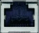
H51X – SIL3 architecture mono
F-PWR 01
F-PWR 01
F-PWR 01
F-PWR 01
F-PWR 01
F-PWR 02
F-PWR 02
F-CPU 01
blank
F-COM 01
F-COM 01
F-COM 01
F-COM 01
F-COM 01
F-COM 01
F-COM 01
F-COM 01
F-COM 01
F-COM 01
System Configuration
max. 16 I/O extension racks
In 1 or 2 lines
Advantage: Fault tolerance up to 2 I/O extension racks
F-BASE RACK 01
I/O #1
I/O #2
I/O #3
I/O #4
I/O #5
I/O #6
I/O #7
I/O #8
I/O #9
I/O #10
I/O #11
I/O #12
I/O #13
I/O #14
I/O #15
I/O #16
F-IOP 01
F 7133
F 7133
F 7133
F 7133
I/O #1
I/O #2
I/O #3
I/O #4
I/O #5
I/O #6
I/O #7
I/O #8
I/O #9
I/O #10
I/O #11
I/O #12
I/O #13
I/O #14
I/O #15
I/O #16
F-IOP 01
F 7133
F 7133
F 7133
F 7133

Slide 24
H51X – SIL3 architecture redundant
F-PWR 01
F-PWR 01
F-PWR 01
F-PWR 01
F-PWR 01
F-PWR 02
F-PWR 02
F-CPU 01
blank
System Configuration:
max. 16 I/O extension racks
2 ring structures
Advantage: Fault tolerance
E.g. exchange of I/O extension racks without loosing connection to other I/O extension racks.
blank
F-COM 01
F-COM 01
F-COM 01
F-COM 01
F-COM 01
F-COM 01
F-COM 01
F-COM 01
F-COM 01
F-COM 01
F-BASE RACK 01
F-CPU 01
I/O #1
I/O #2
I/O #3
I/O #4
I/O #5
I/O #6
I/O #7
I/O #8
I/O #9
I/O #10
I/O #11
I/O #12
I/O #13
I/O #14
I/O #15
I/O #16
F-IOP 01
F 7133
F 7133
F 7133
F 7133
I/O #1
I/O #2
I/O #3
I/O #4
I/O #5
I/O #6
I/O #7
I/O #8
I/O #9
I/O #10
I/O #11
I/O #12
I/O #13
I/O #14
I/O #15
I/O #16
F-IOP 01
F 7133
F 7133
F 7133
F 7133

Slide 25
HIQuad X – H41X
The flexible, scalable safety control system for a wide range of applications.
Notes:
HIQuad systems are highly reliable and can be configured flexibly. They are designed for small and midsized applications in the process industry.
They protect both central and distributed applications with maximum fault tolerance.
They are so flexible that they even allow you to make program changes during operation.
Since launch, HIQuad has become the benchmark for reliable and cost-effective safety solutions in the process industry.

Slide 26
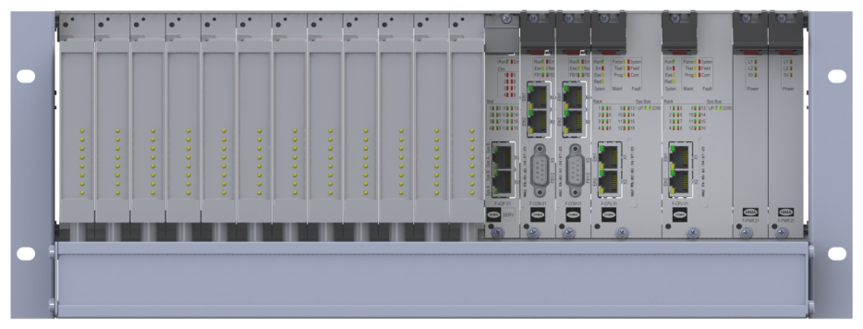
HIQuad X – H41X system
12x I/O
Common usage of H51X components
Up to 12 I/O modules in one rack
Up to 28 I/O modules in two racks
Up to 224 I/O points
For redundant I/O modules additional I/O rack can be used. Electrical and communication connections are foreseen
Engineering recommendation: Instead of using H41X with I/O rack, please use H51X
1x F-IOP
2x F-COM
2x F-CPU
2x F-PWR 01

Slide 27
H41X – Architecture Mono
I/O #1
I/O #2
I/O #3
I/O #4
I/O #5
I/O #6
I/O #7
I/O #8
I/O #9
I/O #10
I/O #11
I/O #12
F-IOP 01
F-COM 01
F-COM 01
F-CPU 01
blank
F-PWR 01
F-PWR 01
F-BASE RACK 02

Slide 28
H41X – Architecture Redundant
I/O #1
I/O #2
I/O #3
I/O #4
I/O #5
I/O #6
I/O #7
I/O #8
I/O #9
I/O #10
I/O #11
I/O #12
F-IOP 01
F-COM 01
F-COM 01
F-CPU 01
blank
F-CPU 01
F-PWR 01
F-PWR 01
I/O #1
I/O #2
I/O #3
I/O #4
I/O #5
I/O #6
I/O #7
I/O #8
I/O #9
I/O #10
I/O #11
I/O #12
I/O #13
I/O #14
I/O #15
I/O #16
F-IOP 01
F 7133
F 7133
F 7133
F 7133

Slide 29

HIQuad X Hardware Overview

Slide 30
HIQuad X – Ersatzteile / Spare Parts
Ersatzteile / spare parts
HIQuad X | TN / Part No. | Deutsch | Englisch
F-CPU 01 | 98 4866102 | Prozessormodul H51X, H41X (2x RJ-45, SIL 3), Schutzlackierung | Processor module H51X, H41X (2x RJ-45, SIL 3), coated
F-COM 01 | 98 4867202 | Kommunikationsmodul für Ethernet, Profibus DP und serielle Kommunikation (2x RJ-45, 1 x 9-polige D-SUB (2x RS 485), Schutzlackierung | Communication module for Ethernet, Profibus DP and serial communication (2x RJ-45, 1 x 9-pole D-Sub 2x RS 485)
F-BASE RACK 01 | 99 6142100 | Basisrack H51X, 19 Zoll, 4 HE | Base rack H51X, 19 inches, 4 units high
F-BASE RACK 02 | 99 6142200 | Basisrack H41X, 19 Zoll, 4 HE, 12 E/A Steckplätze | Base rack H41X, 19 inches, 4 units high, 12 slots for I/O modules
F-BASE RACK 11 | 99 6140600 | Bleibt bestehen K 1406 Erweiterungsrack H41X, H51X, H51q, 19 Zoll, 4 HE, 16 E/A Steckplätze | Remains the same K 1406 Extention rack H41X/H51X, H51q, 19 inches, 4 units high, 16 slots for I/O modules
(=K 1406)
F-PWR 01 | 98 4714102 | Netzgerätemodul 24 VDC / 5 VDC, 50W, H41X, H51X, Schutzlackierung | Power supply module 24 VDC / 5 VDC, 50 W, H41X, H51X
F-PWR 02 | 98 4714202 | Watchdog Versorgungsmodul für Erweiterungsracks, H51X, Schutzlackierung | Watchdog supply module for extension rack, H51X
F-IOP 01 | 98 4850102 | 2 E/A Verarbeitungsmodul (SIL 3) mit redundantem Systembus, Schutzlackierung | I/O processing module (SIL 3) with redundant system bus

Slide 31
Supported I/O modules – Input
I/O modules | SIL | Channels | OC/SC | Ex | Note
Input modules digital
F 3221 |  | 16 | - | - | Contacts, 1 signal 24 VDC
F 3224A |  | 4 | - | yes | Contacts, 1 signal, SN-, proximity switches, wired contacts, ATEX
F 3236 | 3 | 16 | - | - | Contacts, 1 signal 24 VDC
F 3240 | 3 | 16 | - | - | Contacts, 1 signal 110 VDC/127 VAC
F 3248 | 3 | 16 | - | - | Contacts, 1 signal 48 VDC
Input modules Initiator
F 3237 | 3 | 8 | yes | - | SN-, proximity switches, wired contacts
F 3238 | 3 | 8 | yes | yes | SN-, proximity switches, wired contacts, 8 DU wide, ATEX
Input modules analog
F 6215 | 3 | 8 | yes | - | Current, voltage, Pt100
F 6217 | 3 | 8 | yes | - | Current, voltage
F 6220* | 3 | 8 | yes | - | Thermoelemente, Pt100, ATEX, *supported in HIQuad X, but EOL reached!
F 6221 | 3 | 8 | yes | yes | Current, voltage, ATEX
Special modules
F 5220 | 3 | 2 | yes | - | Counter module initiator, 5 VDC, 24 V DC to 1 MHz, 2 integral digital outputs 24 VDC to 0.5 A
Notes:
* Module supported in HIQuad X, but it is since 2019 obsolete.

Slide 32
Supported I/O modules – Output
I/O modules | SIL | Channels | OC/SC | Ex | Note
Output modules digital
F 3322 |  | 16 | - | - | 24 VDC to 0.5 A
F 3325 | 3 | 6 | - | yes | Ex transmitter supply module for F 6221, ATEX
F 3330 | 3 | 8 | - | - | 24 VDC to 0.5 A
F 3331 | 3 | 8 | yes | - | 24 VDC to 0.5 A
F 3333 | 3 | 4 | - | - | 24 VDC to 2 A
F 3334 | 3 | 4 | yes | - | 24 VDC to 2 A
F 3335 | 3 | 4 | - | yes | 24 VDC, ATEX
F 3349* | 3 | 8 | yes | - | 24 VDC/48 V DC to 0.5 A
F 3422 |  | 8 | - | - | Relay module, 30 VAC/DC, 120 W, floating NO contact
F 3430 | 3 | 4 | - | - | Relay module, 110 VDC/250 V AC to 4 A
Output modules analog
F 6705 | 3 | 2 | - | - | Current
F 6706 |  | 2 | - | - | Current
Notes:
*F 3349 is supported in HIQuad X, but
Hardware revision AS00 is recommended to be exchanged with hardware revision AS01
With hardware revision AS01 the availability is increased.
The hardware revision is written on the label
The new color code RAL9002 (white) is a strong indicator that you have the up to date hardware revision AS01
The old color code RAL7032 (industry-grey) is a strong indicator that you have the hardware revision AS00, which is recommended to be exchange during the modernization from HIQuad to HIQuad X

Slide 33

HIQuad X – Communication

Slide 34
One Safe Communication Platform HIQuad X – HIMax – HIMatrix – HIQuad
Benefit:
Partial system modernization possible
Enables partial plant modernization in incremental steps
Freedom of system choice – allows the combination of all HIMA PES
Enables the simple expansion of applications and plants

Slide 35
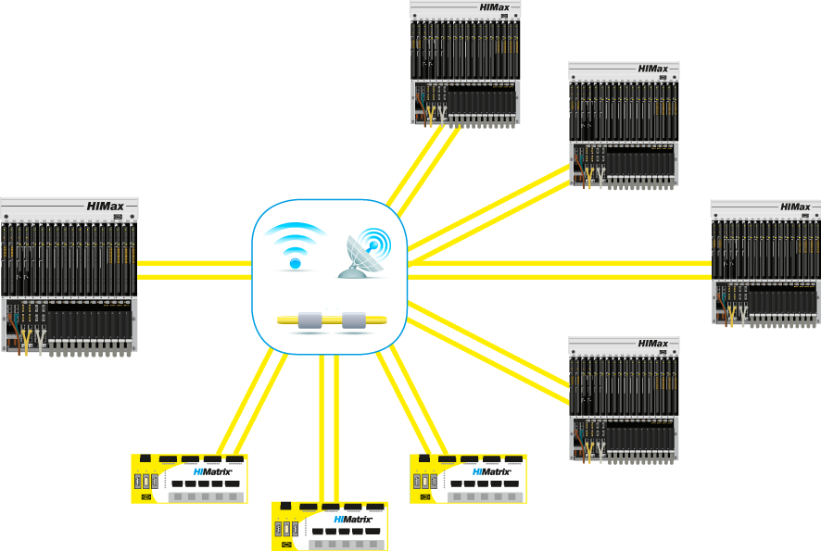
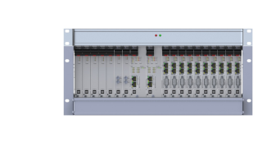
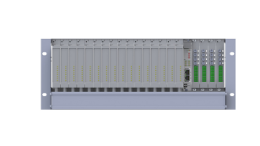
Safety-Related Networking via safeethernet
Data transmission at 1 GBit/s
Fast response times, even for networked applications
Utilizes standard Ethernet components and functions for safety-critical applications
Use of any transmission media
255 safeethernet connections per System (between PES red. Connection possible)
Intelligent, diverse redundancy concepts
Unique: reloadable safety protocol
safeethernet on any Ethernet infrastructure (black channel) Virtually no limit in the extension

Slide 36


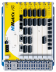
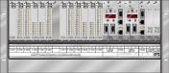
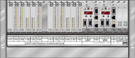

Safe communication – HIPRO-S V2
XML-Export
HIPRO-S V2 configuration
V5.6
≥ V8.4
V1 and/or V2
192.168.0.X
HK- COM3
HK- COM3
≤ 64 Connections
≤ 505 Bytes
HIBUS

Slide 37
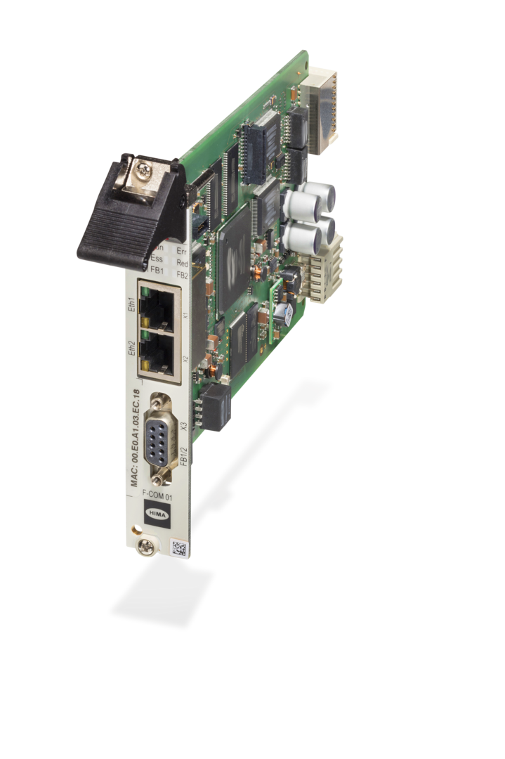
HIQuad X – Communication
Hardware-Features:
H51X: Peer-to-peer connection from every F-CPU 01 to every of 10x F-COM 01
H41X: Peer-to-peer connection from every F-CPU 01 to every of 2x F-COM 01
2 ETH interfaces per F-CPU 01 for PADT and safeethernet communication
2 ETH interfaces per F-COM 01 for all communication protocols
Serial interface for existing old protocols
Parameterization and configuration:
Complete IP address range can be used
Subnet mask settings can be changed
V-LAN settings for network segmentation can be parameterized
Supports standard and safety protocols

Slide 38
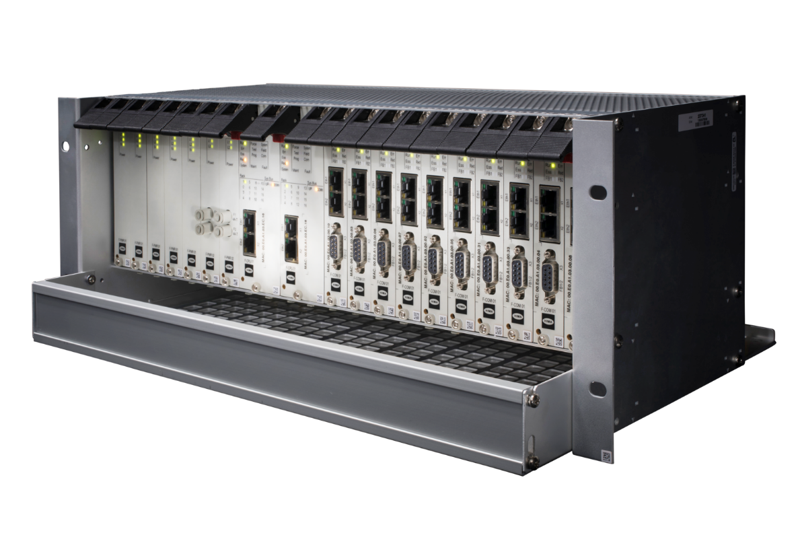
HIQuad X – Communication Protocols
Safety Communication:
safeethernet
HIPRO-S V2
Standard Communication:
Modbus TCP Master & Slave
Modbus RTU Master & Slave
Profibus DP Slave
X-OPC Server for OPC DA and OPC A&E
COM User Task (CUT) individual protocol programming

Slide 39


HIMA Systems Integrate with All Leading DCSs
Notes:
Distributed control systems (DCSs) are crucial for controlling and monitoring your plants. HIMA safety systems can be integrated into your existing distributed control systems, but still run independently and are physically separated. This makes an important contribution to plant safety, enables central monitoring of all components, and prevents errors in the distributed control system from affecting the safety system. It continues running smoothly.
Customers can combine the best distributed control system for their application and the most suitable safety solution. This is only possible with HIMA, as HIMA is the only company with the necessary expertise. DCS integration is an extremely complex area, especially as there are so many vendors. At HIMA, we have established our own Competence Center, 100% dedicated to this task.

Slide 40



HIQuad X – Security
Notes:
Änderungswunsch:
Darstellung einheitlich machen.
Aus den 3 Folien möglichst 2 Folien machen. Gleichartige Darstellung für Tunneln und external extraction.

Slide 41

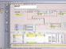
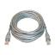
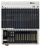
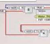
Security – Protective Measurements
PC Environment
Antivirus
Firewall
Engineering Tool
SILworX
CRC protection
User Management
Communication
Physical separation
Open Standards
Smart Safety Platform
HIMax / HIQuad X / HIMatrix
Safety Application
Access protection
Port Locking
CRC protection
Change control
Access protection
Change Management
Only configured Data
Key Switch

Slide 42
Cyber Security – layer of protection via virtual and physical segregation
Virtual segregation via firewall on safety CPU
Allow configured data exchange only
Use valid telegrams only
SIL3 Memory protection: Usage of independent memory
SIL3 timing protection: Uses only configured COM time slice
Physical segregation via separate COM Module
Firewall features as above
Additional independent layer of protection
Systembus
safety
Standard communication
com

Slide 43

Prepare HIQuad X Modernization

Slide 44
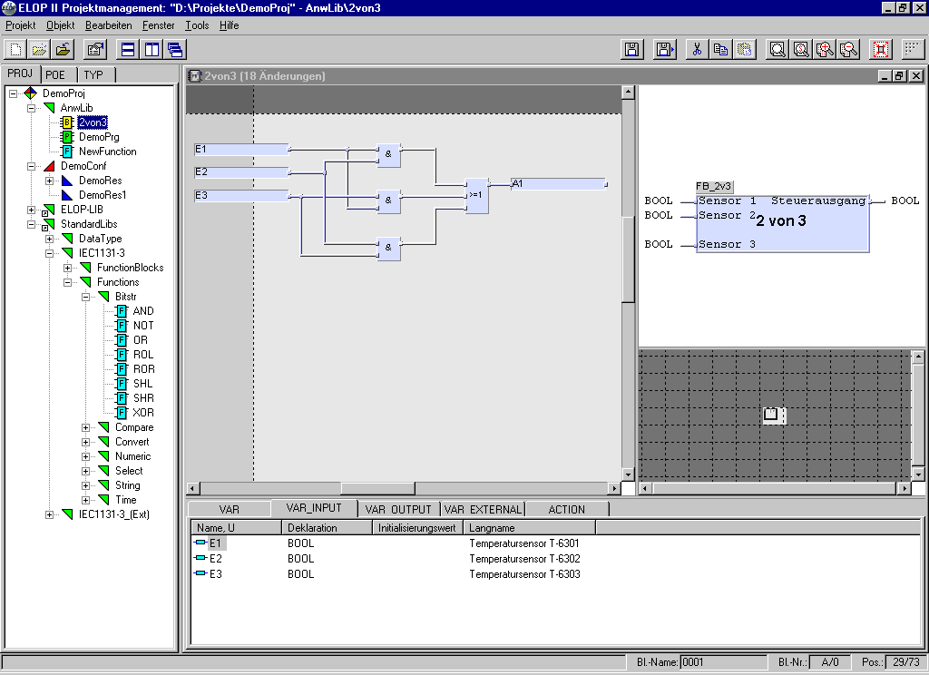
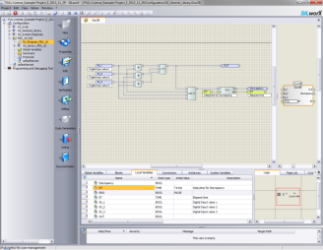
ELOP II Modernization Service
ELOP II
≥V5.6
Logic Conversion
≥V8.xx.x
Modernization Service by HIMA

Slide 45
HIQuad X – Modernization effort
Less effort compared to a completely new installation!
Acceptance test needs to be renewed
Logic conversion needs to be reworked
Not all I/O modules are reusable, only modules of price list 2016
For installation
Central rack needs to be renewed
New module F-IOP 01 allows system bus
X-OPC Server and SNTP are the substitutes
Notes:
Change:
No Display – SILworX must be used for
CRC indication of system
Operating system revision

Slide 46
Which activities are needed to prepare HIQuad X in existing plants?
Organisation
Installed base
When should the shutdown be implemented?
Inventory of HIQuad systems
Of which modules consists the system including hardware revision?
HIQuad network plan
How many systems run in one network (networking partners and addresses)?
Modbus Master IP-address and Modbus address list
Which safe communication runs within the system (HIPRO-S V1 or V2)?
Replace legacy HIQuad modules by active ones.
Latest CPU and COM modules of HIQuad support HIPRO-S V2.
E.g. F 6214
Make sure, that all systems are installed referring to the present standards.
H 7034 net filter 24 VDC
Exchange F 3349 to latest revision AS01
E.g. system fan K 9203A every 2nd extension rack

Slide 47

SILworX®
High-end safety engineering
Notes:
The new engineering Software Platform
Specialised for safety engineering
Manager for all HIMA safety systems and Applications
Easy and efficient through concentration on safety programming
Referent Note:
What is the USP (Unique selling point) of Software?
Today the Features between different Software Products are all similar. The difference is how this Features work in detail and how easy it is to use them.
To show the “Ease of use” is difficult. Therefore we recommend different ways to present the software:
Use SILworX_Intro_E_xx.ppt PowerPoint.
Give a live demonstration (Create a Project live)
If you have only limited presentation time or when the client is not interested in details of Engineering. The next Slides will give an main overview of the SILworX functionality

Slide 48
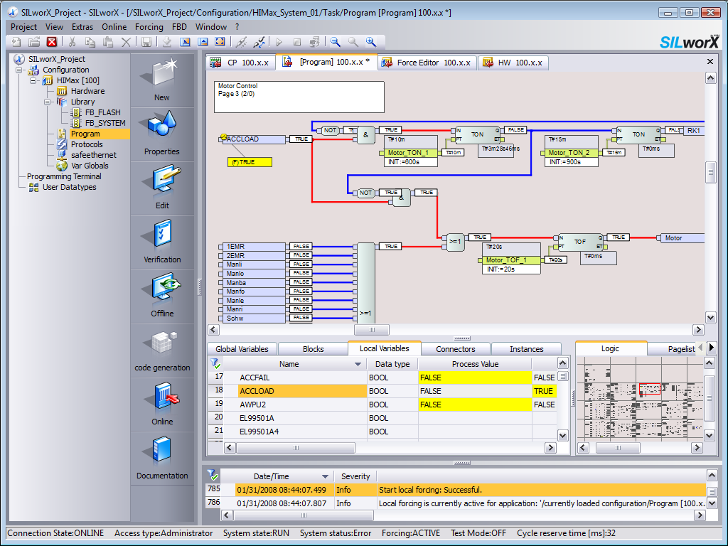
SILworX® High-End Safety Engineering
One engineering tool for HIMax®-, HIMatrix®-, and HIQuad®X-Systems
Fully integrated configuration, programming and diagnostic environment
IEC 61131-3 programming:
function block diagrams (FBD),
sequential function charts (SFC),
structured text (ST)
Certified function blocks
Password protection for projects and controller access
Notes:
Overview of the main Benefits and functions of SILworX.
Referent Note:
Use this slide if you have only limited presentation time or when the client is not interested in details of Engineering. This Slides will give an main overview of the SILworX functionality

Slide 49
SILworX® High-End Safety Engineering
Offline simulation and online test
SIL3 comparator for hardware and logic changes
Supports reload functionality for hardware, communication and logic changes
Multitasking for up to 32 independent programs
C-Code function block option for using pretested C-Code within safety systems
Hardware import/export via XML
Compatible with Microsoft Windows 10
Notes:
Overview of the main Benefits and functions of SILworX.
Referent Note:
Use this slide if you have only limited presentation time or when the client is not interested in details of Engineering. This Slides will give an main overview of the SILworX functionality

Slide 50
SILworX Multitasking
SILworX Multitasking
ESD
F&G
BMS
HIPPS
etc.
Independence in the system
Different applications/programs
Time-/ critical and non-critical applications
Safe and nonsafe applications
Each program can be modified without affecting others
Individual checksums for minimal certification effort
Add applications interference-free
Each program with individual cycle/scan time
Target cycle time possible for each application (controller)

Slide 51


Preview SMART SAFETY TEST
Feature in SILworX v10
Permanent increasing quality requirements
and high effort to test application programs
in safety PLCs initiated the idea of
SMART SAFETY TEST

Slide 52
Motivation – current standards
„In IEC 61511 Ed2 part 1, chapter 15.2.2 SIS safety Validation:
“Validation planning for the application program shall include the following:
The technical strategy for the validation including (where relevant):
– manual and automated techniques;”
„IEC 61511 Ed2 part 2 B.2 Application program development and validation philosophy“:
Semi-automatic testing through model checking in order to verify whether each AP module meets its functional and safety specifications;
Notes:
Die Möglichkeit automatische Testabläufe im sicheren Engineering Tool zu definieren bietet Vorteile im gesamten safety Lebenszyklus.
Kunden gewinnen einen Qualitäts- und Sicherheitsvorteil bei gleichzeitiger Reduzierung der Lebeszykluskosten (OPEX) für wiederkehrende Validierungsaufgaben wie Proof-Tests oder Re-Validierung bei Änderungen.

Slide 53
Test Management
Test Execution
Dynamic, function orientated test can be executed.
You have the following benefits by using Smart Safety:
Ability to reproduce
Time saving
Increased test quality
Execution of regression tests
Generating test cases
Test Results
Test Management
Specification
Test Documentation

Slide 54
Smart Safety Test
Supports the usage of recommended methods regarding tests and acceptance
Defined test cases are reusable
Defined test cases are up to date at any time
Automated tests can be executed without user interrupts
Automated revalidation in case of changes
Usable to support and document proof tests
Automated documentation of the test execution and results
Smart Safety Test is direct executable on the safety PLC
Released with SILworX V10

Slide 55
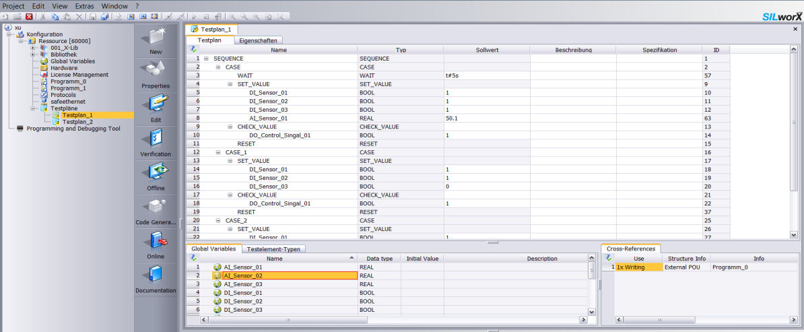
Smart Safety Test - Editor
Definition of test sequence
Edit the testplan
Drag & Drop
Cross conference with goto function
Choose the test elements
Choose the global variables

Slide 56
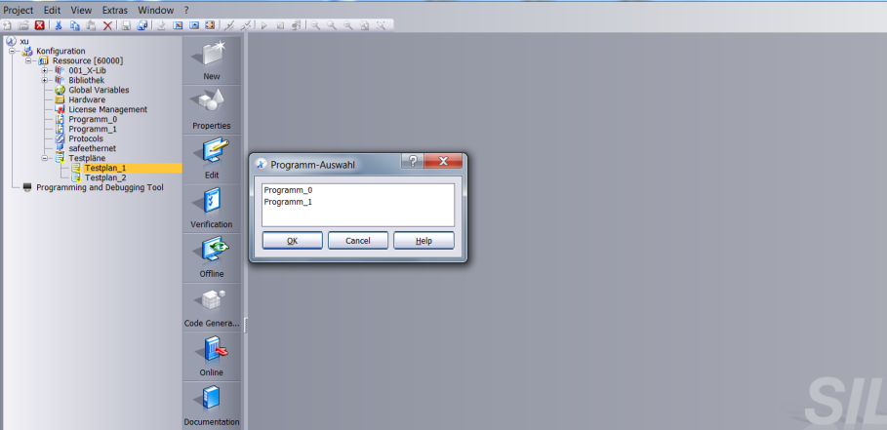
Smart Safety Test - Test execution Off- / Online
Choosing for the Multitasking
Execute the test plan in offline simulation or online

Slide 57
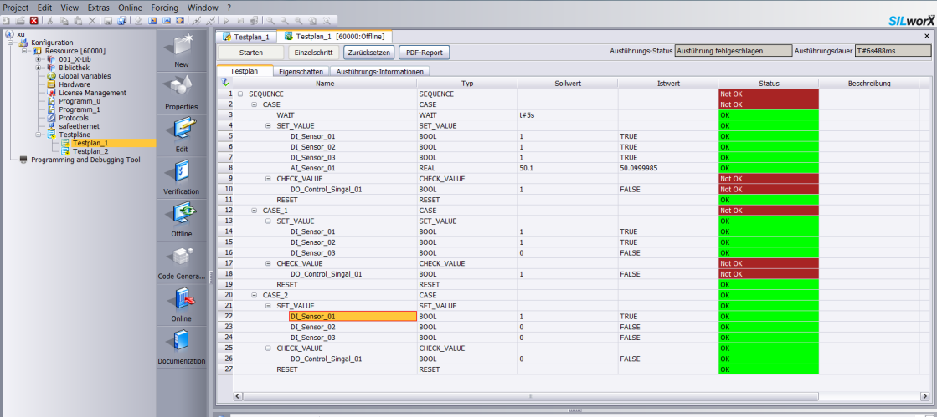
Smart Safety Test - Test execution Off- / Online
Test operation
Test Procedure
Comparing of test result
Testergebnis
Setting breakpoint
Execute the test plan in offline simulation or online
Notes:
Test operation: start, stop, reset, export test report
Comparing of test result: set value and real value, the result will be shown in the status
Set breakpoint for each step

Slide 58
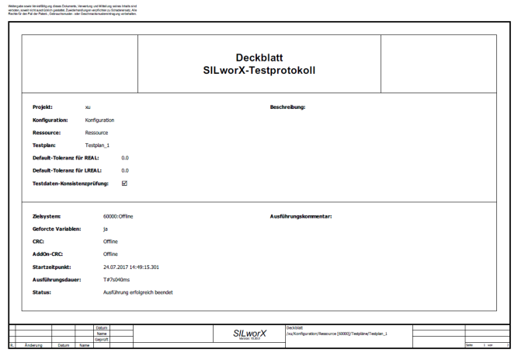
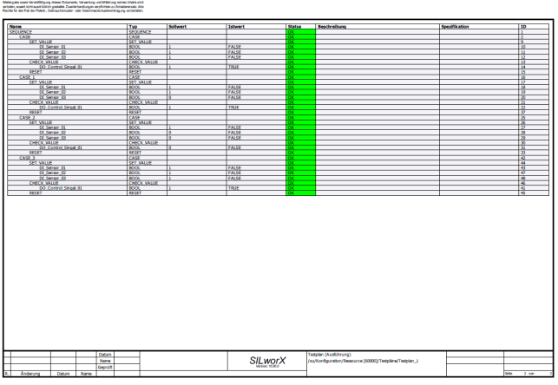
Smart Safety Test - Test Report as PDF / csv / …

Slide 59

Thank you for your attention! Sebastian Dänner Product Manager HIQuad X Head of Component Obsolescence Management
HIMA Paul Hildebrandt GmbH
Albert-Bassermann-Str. 28
68782 Brühl, Germany
Phone: +49 (0) 6202 / 709-819
Fax: +49 (0) 6202 / 709-107
Email: s.daenner@hima.com
Website: www.hima.com

